Slide 1

Course Code: CSE 2203
Course Title: Digital Techniques
Heaven’s Light is Our Guide
Department of Computer Science & Engineering
Rajshahi University of Engineering & Technology, Bangladesh
Date : 28.08.2017
Session : III
Topic : Binary Arithmetic System
Faculty : Dr. Boshir Ahmed
Professor
Department of CSE, RUET
E mail: boshir78@gmail.com

Slide 2
Binary Arithmetic
Binary addition
Binary subtraction
Binary multiplication
Binary division

Slide 3
Complements of Binary Numbers
1’s complements
2’s complements

Slide 4
Complements of Binary Numbers
1’s complement
Change all 1s to 0s and all 0s to 1s
1 0 1 0 1 0 1 0
0 1 0 1 0 1 0 1

Slide 5
Complements of Binary Numbers
2’s complement
Find 1’s complement and then add 1
1 0 1 0 1 0 1 0
1
1’s complement
0 1 0 1 0 1 0 1
Input bits
Adder
Output bits (sum)
Carry
In
(add 1)
2’s complement
0 1 0 1 0 1 1 0

Slide 6
Signed Numbers

Slide 7
Topics for Signed Numbers
Signed-magnitude form
1’s and 2’s complement form
Decimal value of signed numbers
(How to convert)
Range of values (max and min)
Floating-point numbers

Slide 8
Signed Numbers
Signed-magnitude form
  The sign bit is the left-most bit in a signed binary number
  A 0 sign bit indicates a positive magnitude
  A 1 sign bit indicates a negative magnitude

Slide 9
Signed Numbers
1’s complement form
  A negative value is the 1’s complement of the corresponding positive value
2’s complement form
  A negative value is the 2’s complement of the corresponding positive value

Slide 10
Signed Numbers
Decimal value of signed numbers
  Sign-magnitude
  1’s complement
  2’s complement

Slide 11
Signed Numbers
Range of Values
Total combinations = 2^{n}
  2’s complement form:
– (2^{n – 1}) to + (2^{n – 1} – 1)
Range for 8 bit number:
n = 8
-(2⁸⁻¹) = -2⁷ = -128 minimum
+(2⁸⁻¹) – 1 = +2⁷ - 1 = +127 maximum
Total combination of numbers is 2⁸ = 256.

Slide 12
Signed Numbers
Range for 16 bit number:
n = 16
-(2¹⁶⁻¹) = -2¹⁵ = -32768 minimum
+(2¹⁶⁻¹) - 1 = +2¹⁵ = +32767 maximum
Total combinations is 2¹⁶ = 65536 (64K)
8 bit examples:
10000000 =
-128
11111111 =
-1
10000001 =
-127
01111111 =
+127

Slide 13
Arithmetic Operations with Signed Numbers
Addition
Subtraction
Multiplication
Division

Slide 14
Arithmetic Operations with Signed Numbers
Addition of Signed Numbers
The parts of an addition function are:
  Augend - The first number
  Addend - The second number
  Sum - The result
Numbers are always added two at a time.

Slide 15
Arithmetic Operations with Signed Numbers
Four conditions for adding numbers:
1. Both numbers are positive.
2. A positive number that is larger than a negative number.
3. A negative number that is larger than a positive number.
4. Both numbers are negative.

Slide 16
Arithmetic Operations with Signed Numbers
Signs for Addition
When both numbers are positive, the sum is positive.
When the larger number is positive and the smaller is negative, the sum is positive. The carry is discarded.

Slide 17
Arithmetic Operations with Signed Numbers
Signs for Addition
When the larger number is negative and the smaller is positive, the sum is negative (2’s complement form).
When both numbers are negative, the sum is negative (2’s complement form). The carry bit is discarded.

Slide 18
Examples (8 bit numbers)
Add 7 and 4 (both positive)
Add 15 and -6 (positive > negative)
Add 16 and -24 (negative > positive)
Add -5 and -9 (both negative)
00000111 7
+00000100 + 4
00001011 11
00001111 15
+11111010 + -6
1 00001001 9
Discard carry
00010000 16
+11101000 + -24
11111000 -8
Sign bit is negative so negative number in 2’s complement form
11111011 -5
+11110111 + -9
1 11110010 -14
Discard carry

Slide 19
Overflow
Overflow occurs when number of bits in sum exceeds number of bits in addend or augend.
Overflow is indicated by the wrong sign.
Occurs only when both numbers are positive or both numbers are negative
01111101 126
+ 00111010 + 58
_________ ____
10110111 183
Sign Incorrect
Magnitude Incorrect

Slide 20
Arithmetic Operations with Signed Numbers
Subtraction of Signed Numbers
The parts of a subtraction function are:
  Minuend - The first number
  Subtrahend - The second number
  Difference - The result
Subtraction is addition with the sign of the subtrahend changed.

Slide 21
Arithmetic Operations with Signed Numbers
Subtraction
The sign of a positive or negative binary number is changed by taking its 2’s complement
To subtract two signed numbers, take the 2’s complement of the subtrahend and add. Discard any final carry bit.

Slide 22
Subtraction Examples
Find 8 minus 3.
Find 12 minus -9.
Find -25 minus 19.
Find -120 minus -30.
00001000 8
+11111101 - 3
1 00000101 5
Minuend
Subtrahend
Difference
Discard carry
00001100 12
+00001001 - -9
00010101 21
11100111 -25
+11101101 - 19
1 11010100 -44
Discard carry
10001000 -120
+00011110 - -30
10100110 -90

Slide 23
Arithmetic Operations with Signed Numbers
Multiplication of Signed Numbers
The parts of a multiplication function are:
  Multiplicand - First number
  Multiplier - Second number
  Product - Result
Multiplication is equivalent to adding a number to itself a number of times equal to the multiplier.

Slide 24
Arithmetic Operations with Signed Numbers
There are two methods for multiplication:
Direct addition
  add multiplicand multiple times equal to the multiplier
  Can take a long time if multiplier is large
Partial products
  Similar to long hand multiplication
The method of partial products is the most commonly used.

Slide 25
Arithmetic Operations with Signed Numbers
Multiplication of Signed Numbers
If the signs are the same, the product is positive. (+ X + = + or - X - = +)
If the signs are different, the product is negative. (+ X - = - or - X + = -)

Slide 26
Multiplication Example
Both numbers must be in uncomplemented form
Multiply 3 by -5.
Opposite signs, so product will be negative.
3₁₀ = 00000011₂
-5₁₀ = 11111011₂
2’s complement of -5
00000101
00000011 Multiplicand
X 00000101 Multiplier
00000011 First partial product
+ 0000000 Second partial product
00000011 Sum of 1st and 2nd
+ 000011 Third partial product
00001111 Sum and Final Product
Final result is negative, so take 2’s complement.
11110001 is the result which in decimal is -15.

Slide 27
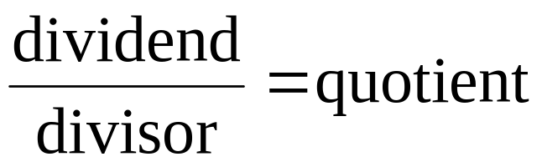
Arithmetic Operations with Signed Numbers
Division of Signed Numbers
The parts of a division operation are:
  Dividend
  Divisor
  Quotient
Division is equivalent to subtracting the divisor from the dividend a number of times equal to the quotient.

Slide 28
Arithmetic Operations with Signed Numbers
Division of Signed Numbers
If the signs are the same, the quotient is positive. (+ ÷ + = + or - ÷ - = +)
If the signs are different, the quotient is negative. (+ ÷ - = - or - ÷ + = -)

Slide 29
Division Example
Both numbers must be in uncomplemented form
Divide 01100100 by 00110010.
Both numbers are positive so
quotient will be positive.
Set the quotient to zero initially.
quotient: 00000000
01100100 Dividend
+ 11001110 2’s complement of Divisor
1 00110010 First partial remainder
Add 1 to quotient: 00000000 + 1 = 00000001
Subtract the divisor from the
dividend by using 2’s complement
addition. (11001110)
Ignore the carry bit.
00110010 First partial remainder
+ 11001110 2’s complement of Divisor
1 00000000 zero remainder
Add 1 to quotient: 00000001 + 1 = 00000010
Subtract the divisor from the
1st partial remainder using 2’s complement addition.
So final quotient is 00000010 and final remainder is 00000000

Slide 30
BCD Code
Binary Coded Decimal (BCD) is a widely used
way to present decimal numbers in binary form.
  Combines features of both decimal and binary systems.
    Each digit is converted to a binary equivalent.
BCD is not a number system.
  It is a decimal number with each digit encoded
  to its binary equivalent.
A BCD number is not the same as a straight binary number.
  The primary advantage of BCD is the relative
  ease of converting to and from decimal.
Copyright ©2007 by Pearson Education, Inc.
Columbus, OH 43235
All rights reserved.

Slide 31
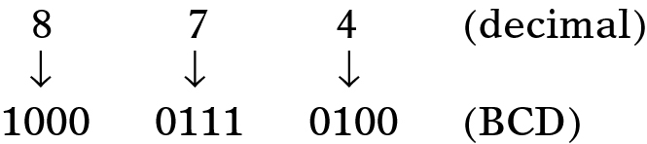
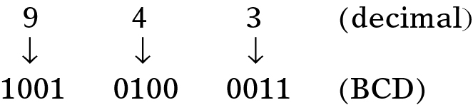
BCD Code
Convert the number 874₁₀ to BCD:
  Each decimal digit is represented using 4 bits.
    Each 4-bit group can never be greater than 9.
Reverse the process to convert BCD to decimal.
Ronald Tocci/Neal Widmer/Gregory Moss
Digital Systems: Principles and Applications, 10e
Copyright ©2007 by Pearson Education, Inc.
Columbus, OH 43235
All rights reserved.

Slide 32
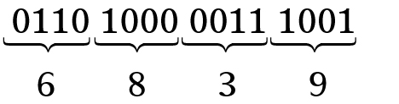
BCD Code
Convert 0110100000111001 (BCD) to its
decimal equivalent.
Divide the BCD number into four-bit
groups and convert each to decimal.
Copyright ©2007 by Pearson Education, Inc.
Columbus, OH 43235
All rights reserved.

Slide 33
BCD Code
Convert 0110100000111001 (BCD) to its
decimal equivalent.
Divide the BCD number into four-bit
groups and convert each to decimal.
Ronald Tocci/Neal Widmer/Gregory Moss
Digital Systems: Principles and Applications, 10e
Copyright ©2007 by Pearson Education, Inc.
Columbus, OH 43235
All rights reserved.

Slide 34
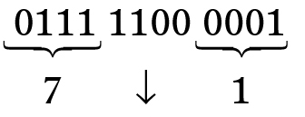
BCD Code
Convert BCD 011111000001 to its decimal equivalent.
The forbidden group represents
an error in the BCD number.
Ronald Tocci/Neal Widmer/Gregory Moss
Digital Systems: Principles and Applications, 10e
Copyright ©2007 by Pearson Education, Inc.
Columbus, OH 43235
All rights reserved.

Slide 35
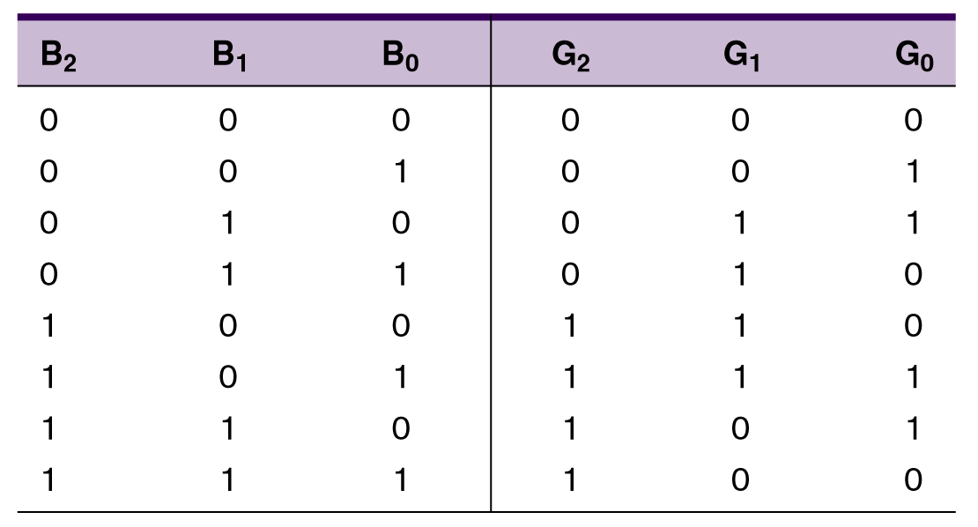
The Gray Code
The Gray code is used in applications where numbers change rapidly.
  Only one bit changes from each value to the next.
Three bit binary
and Gray code equivalents.
Ronald Tocci/Neal Widmer/Gregory Moss
Digital Systems: Principles and Applications, 10e
Copyright ©2007 by Pearson Education, Inc.
Columbus, OH 43235
All rights reserved.

Slide 36
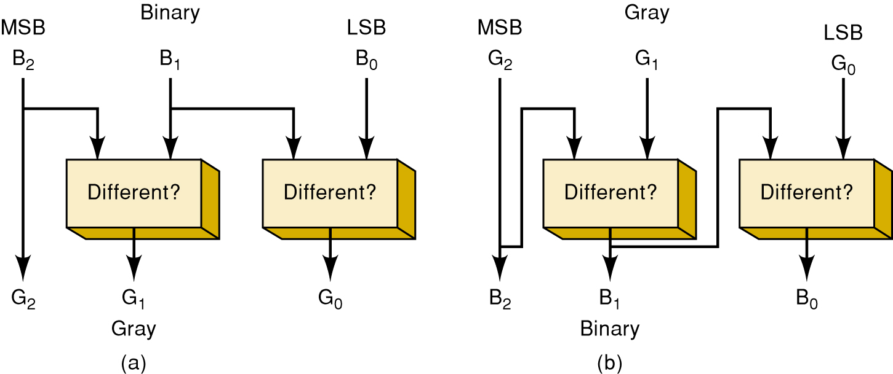
The Gray Code
Binary to Gray Gray to Binary
Ronald Tocci/Neal Widmer/Gregory Moss
Digital Systems: Principles and Applications, 10e
Copyright ©2007 by Pearson Education, Inc.
Columbus, OH 43235
All rights reserved.

Slide 37
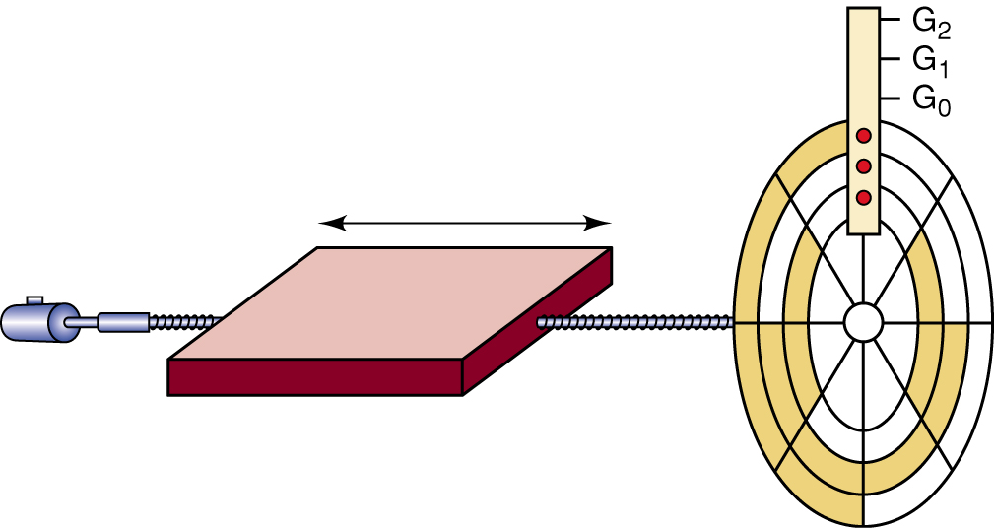
The Gray Code
An eight-position, three-bit shaft encoder
These devices produce a binary
value that represents the position
of a rotating mechanical shaft.
Ronald Tocci/Neal Widmer/Gregory Moss
Digital Systems: Principles and Applications, 10e
Copyright ©2007 by Pearson Education, Inc.
Columbus, OH 43235
All rights reserved.

Slide 38
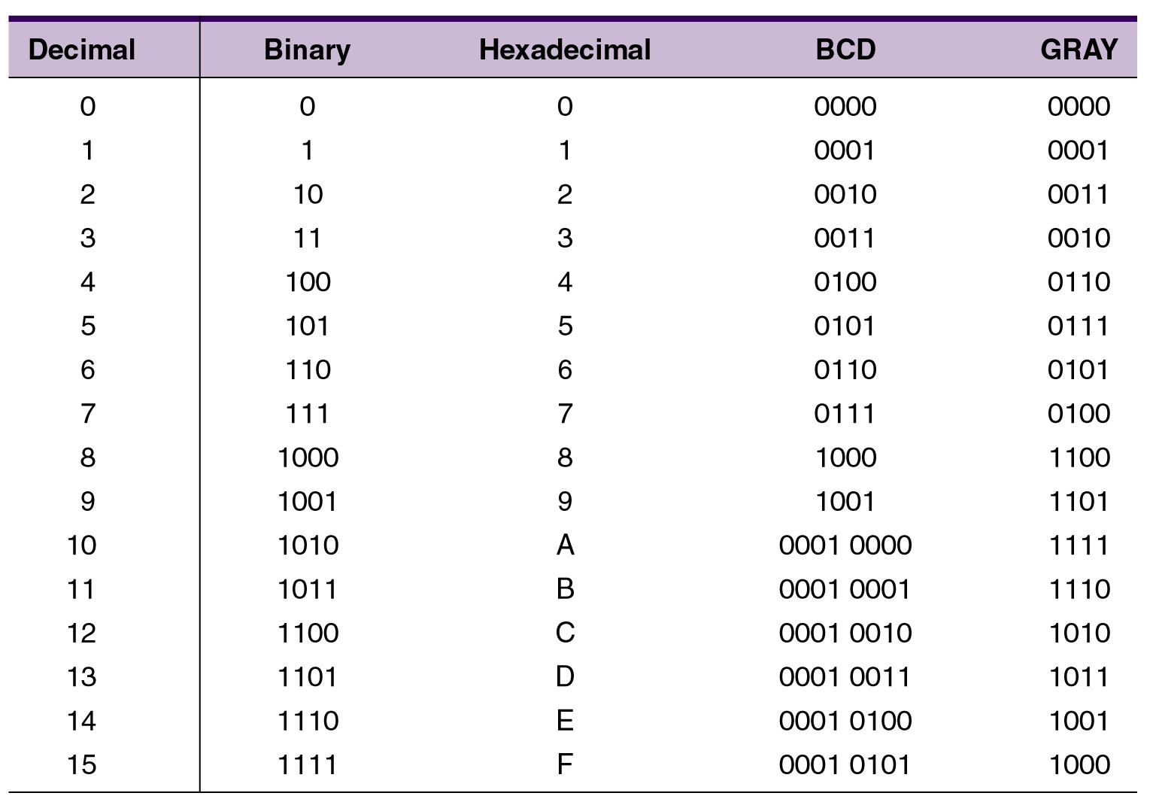
Putting It All Together
Decimal numbers 1 – 15 in binary, hex, BCD, Gray
Ronald Tocci/Neal Widmer/Gregory Moss
Digital Systems: Principles and Applications, 10e
Copyright ©2007 by Pearson Education, Inc.
Columbus, OH 43235
All rights reserved.

Slide 39
The Byte, Nibble, and Word
Most microcomputers handle and store binary data and information in groups of eight bits.
  8 bits = 1 byte.
    A byte can represent numerous types of data/information.
Binary numbers are often broken into groups
of four bits.
  Because a group of four bits is half as big as a
  byte, it was named a nibble.
A word is a group of bits that represents a
certain unit of information.
  Word size can be defined as the number of bits
  in the binary word a digital system operates on.
    PC word size is eight bytes (64 bits).
Ronald Tocci/Neal Widmer/Gregory Moss
Digital Systems: Principles and Applications, 10e
Copyright ©2007 by Pearson Education, Inc.
Columbus, OH 43235
All rights reserved.

Slide 40
Alphanumeric Codes
Represents characters and functions found on
a computer keyboard.
  26 lowercase & 26 uppercase letters, 10 digits,
  7 punctuation marks, 20 to 40 other characters.
ASCII – American Standard Code for Information Interchange.
  Seven bit code: 2⁷ = 128 possible code groups
  Examples of use: transfer information between computers; computers & printers; internal storage.
Ronald Tocci/Neal Widmer/Gregory Moss
Digital Systems: Principles and Applications, 10e
Copyright ©2007 by Pearson Education, Inc.
Columbus, OH 43235
All rights reserved.

Slide 41
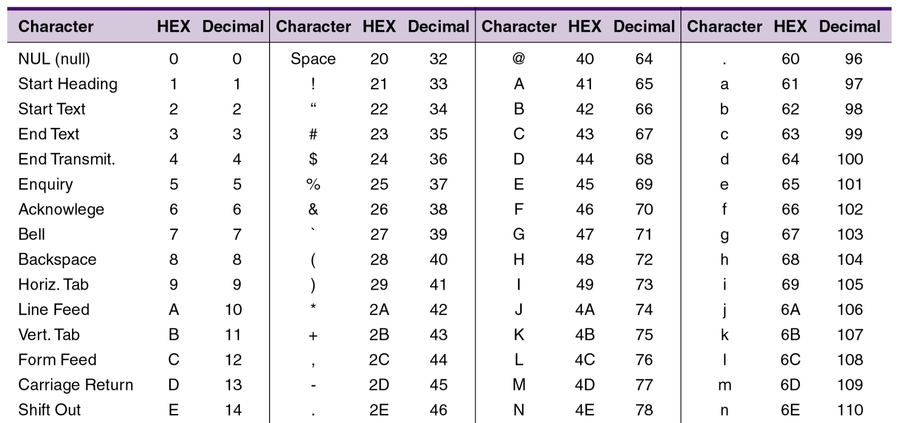
Alphanumeric Codes
ASCII – American Standard Code
for Information Interchange
Ronald Tocci/Neal Widmer/Gregory Moss
Digital Systems: Principles and Applications, 10e
Copyright ©2007 by Pearson Education, Inc.
Columbus, OH 43235
All rights reserved.
See the entire table of your textbook.

Slide 42
Parity Method for Error Detection
Binary data and codes are frequently moved between locations:
  Digitized voice over a microwave link.
  Storage/retrieval of data from magnetic/optical disks.
  Communication between computer systems
  over telephone lines, using a modem.
Ronald Tocci/Neal Widmer/Gregory Moss
Digital Systems: Principles and Applications, 10e
Copyright ©2007 by Pearson Education, Inc.
Columbus, OH 43235
All rights reserved.

Slide 43
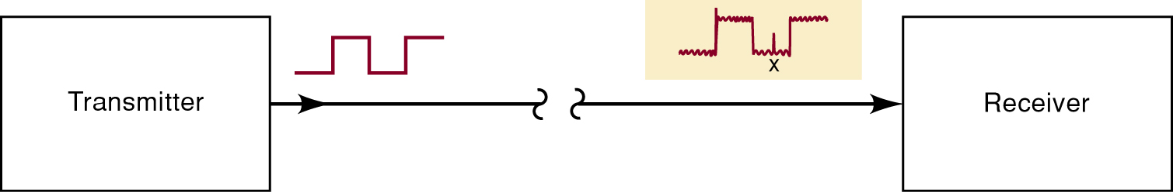
Parity Method for Error Detection
Electrical noise can cause errors during transmission.
  Spurious fluctuations in voltage or current present
  in all electronic systems.
Many digital systems employ methods for error detection—and sometimes correction.
  One of the simplest and most widely used schemes for error detection is the parity method.
Ronald Tocci/Neal Widmer/Gregory Moss
Digital Systems: Principles and Applications, 10e
Copyright ©2007 by Pearson Education, Inc.
Columbus, OH 43235
All rights reserved.

Slide 44
Parity Method for Error Detection
The parity method of error detection requires the addition of an extra bit to a code group.
  Called the parity bit, it can be either a 0 or 1, depending on the number of 1s in the code group.
There are two parity methods, even and odd.
  The transmitter and receiver must “agree” on
  the type of parity checking used.
    Even seems to be used more often.
Ronald Tocci/Neal Widmer/Gregory Moss
Digital Systems: Principles and Applications, 10e
Copyright ©2007 by Pearson Education, Inc.
Columbus, OH 43235
All rights reserved.

Slide 45
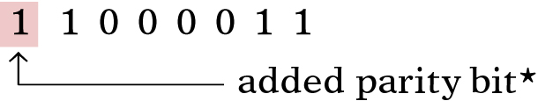
Parity Method for Error Detection
Even parity method—the total number of bits in
a group including the parity bit must add up to
an even number.
  The binary group 1 0 1 1 would require the addition
  of a parity bit 1, making the group 1 1 0 1 1.
    The parity bit may be added at either end of a group.
Ronald Tocci/Neal Widmer/Gregory Moss
Digital Systems: Principles and Applications, 10e
Copyright ©2007 by Pearson Education, Inc.
Columbus, OH 43235
All rights reserved.

Slide 46
Parity Method for Error Detection
Odd parity method—the total number of bits in a group including the parity bit must add up to an odd number.
  The binary group 1 1 1 1 would require the addition
  of a parity bit 1, making the group 1 1 1 1 1.
The parity bit becomes a part of the code word.
Adding a parity bit to the seven-bit ASCII
code produces an eight-bit code.
Ronald Tocci/Neal Widmer/Gregory Moss
Digital Systems: Principles and Applications, 10e
Copyright ©2007 by Pearson Education, Inc.
Columbus, OH 43235
All rights reserved.

Slide 47
Applications
When ASCII characters are transmitted there
must be a way to tell the receiver a new
character is coming.
  There is often a need to detect errors in the transmission as well.
The method of transfer is called asynchronous data communication.

Slide 48
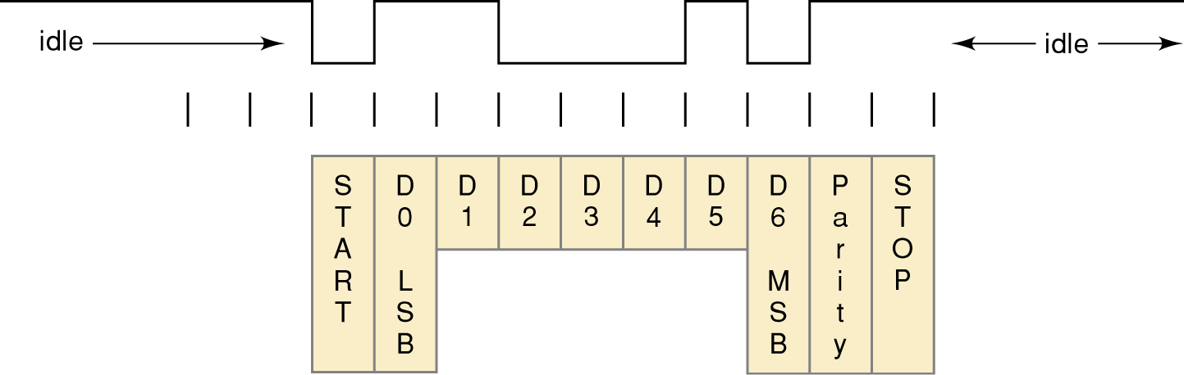
Applications
An ASCII character must be “framed” so the receiver knows where the data begins and ends.
  The first bit must always be a start bit (logic 0).
ASCII code is sent LSB first and MSB last.
  After the MSB, a parity bit is appended to check
  for transmission errors.
  Transmission is ended by sending a stop bit (logic 1).

Slide 49

Thank You

